Slide 1
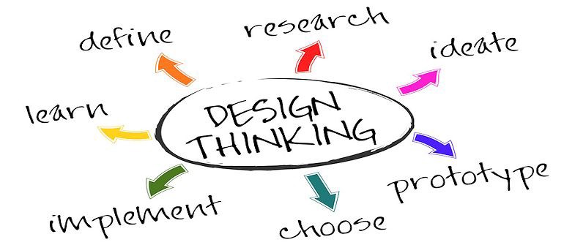
Design Thinking Research - MISSA
Team – VISION R US
By –
Era Singh KajaL
Himani Batra
Neha Gupta
Tanmai Aurangabadkar

Slide 2
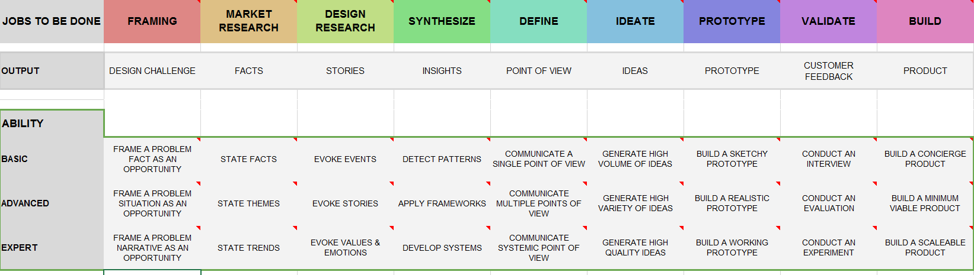
Roadmap

Slide 3
FRAMING
Problem Fact: Theory gives us understanding about a particular concept whereas practical training will give us hands – on experience. In today’s world, practical knowledge is very important to succeed in ones life.
Problem Situation: To overcome the problem of lack of practical cognizance among students, we created an association which provides practical training by connecting with industry experts.
Problem Narrative: MISSA will allow students to connect with fellow students and with professionals to learn from their experiences. Workshops, trainings and certificates will help them enhancing their future path.

Slide 4

MARKET RESEARCH
Market research will identify the potential buyers of the products or services and ask their opinion about the products or services.
Fact - The main focus of our association is to build the communication between student and industry expert.
Theme - From the survey and data analysis we found the highest priority of students is that the association should provide knowledge about the latest technologies and industries and how will it benefit them in the future.
Trend - We built an interpretation that every concept delivered by the industry expert should be elaborated and focuses on the latest technologies.

Slide 5

DESIGN RESEARCH
Design research tells how a specific market segment will interact with a specific product that focuses on the desirability which includes the needs and environment of the users.
Events - Surveys were conducted by face to face interviews where we analyzed the data based on the feedback from the students.
Stories - Based on various stories, we decided to include quizzes, debates and forums in our workshops.
Trends - We need to maintain the satisfaction level of the students by providing answer to all their questions. For this we have a Chat bot service on the student registration portal, which will be guiding student with all the queries and suggestion.

Slide 6
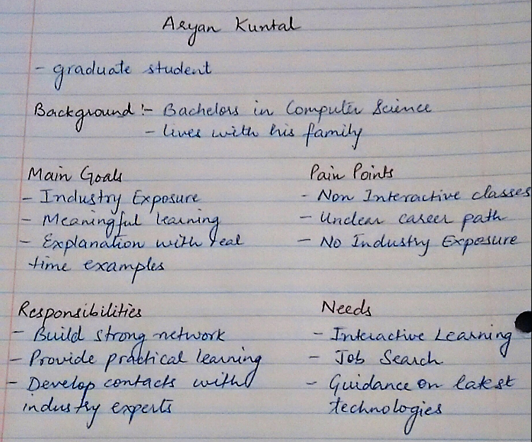
Evoke Stories: Persona Building

Slide 7
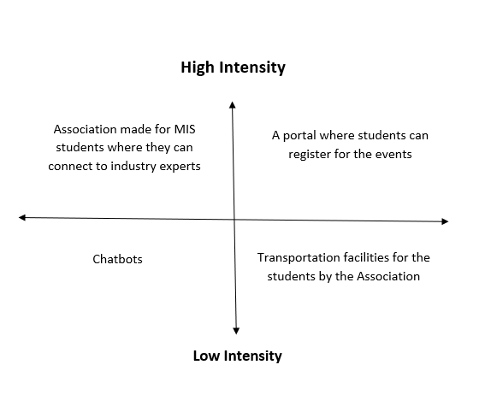
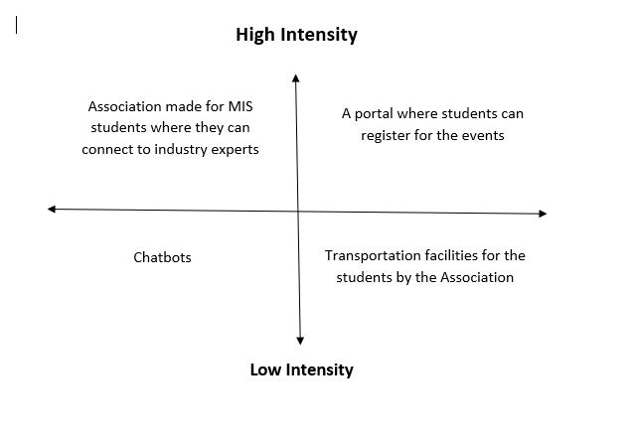
Synthesis Intermediate: Applying Framework

Slide 8
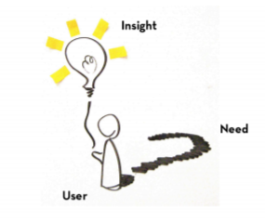
Point of View : Problem Statement
User | Need | Insight
Aryan Kuntal ,a 4 GPA pass out of a well renowned university of California. | Wants Practical training and Industry Exposure | Despite being considered as one of the bright student was not offered any internship. The reason was due to lack of industry exposure and practical learning.

Slide 9
Another Problem Statement
User | Need | Insight
Nishit ,a part-time student of MIS, CSULA | Wants someone to guide him for the future career path. | He never got an opportunity to be a part of association where he get guidance for his future career path.

Slide 10

The following could be the HMW Questions: How might we make students interact with the outside world? How might we increase the satisfaction level of the students? How might we use the knowledge and ideas of students? How might we increase the networking among students? How might we increase the practical learning among the students?

Slide 11

IDEATE:
In our association, we performed brainstorming sessions. Number of ideas were discussed during the brainstorming session.
Most of them suggested that school should provide transportation facility for students coming from radius more than 10 miles.
Some of them wanted financial support to be provided by the association.
Others recommended that students should manage transportation on their own.

Slide 12
IDEATE: Co Cap Metrix
In our Ideate phase we have divided the project in three parts according to the need of events, students and speakers. We have further divided the needs into three main categories which are Physical Product, Online offerings and In Person Engagement. In Physical Product category we focused on the tangible needs. In Online Offering category we focused on what can be fulfilled through the use of technology. In in Person Engagement category we focused on how we can make experience better for students and speakers attending an event.

Slide 13
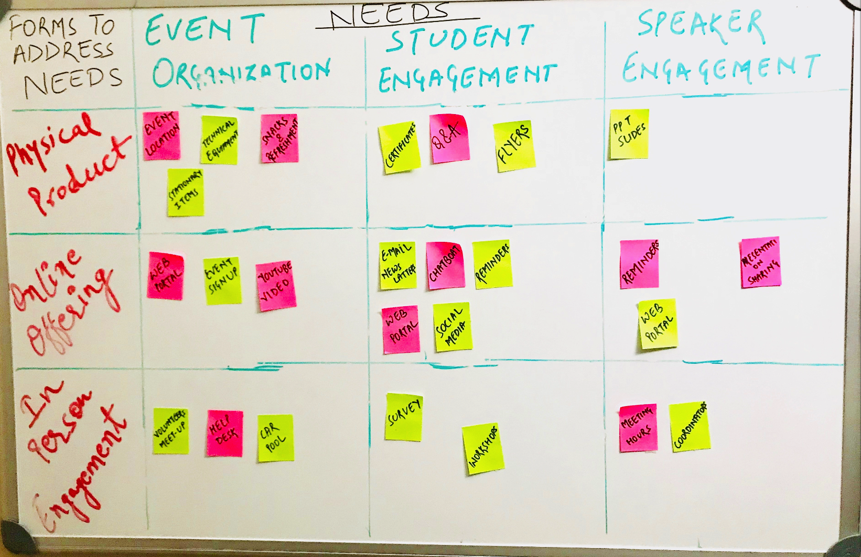
Co Cap Matrix

Slide 14
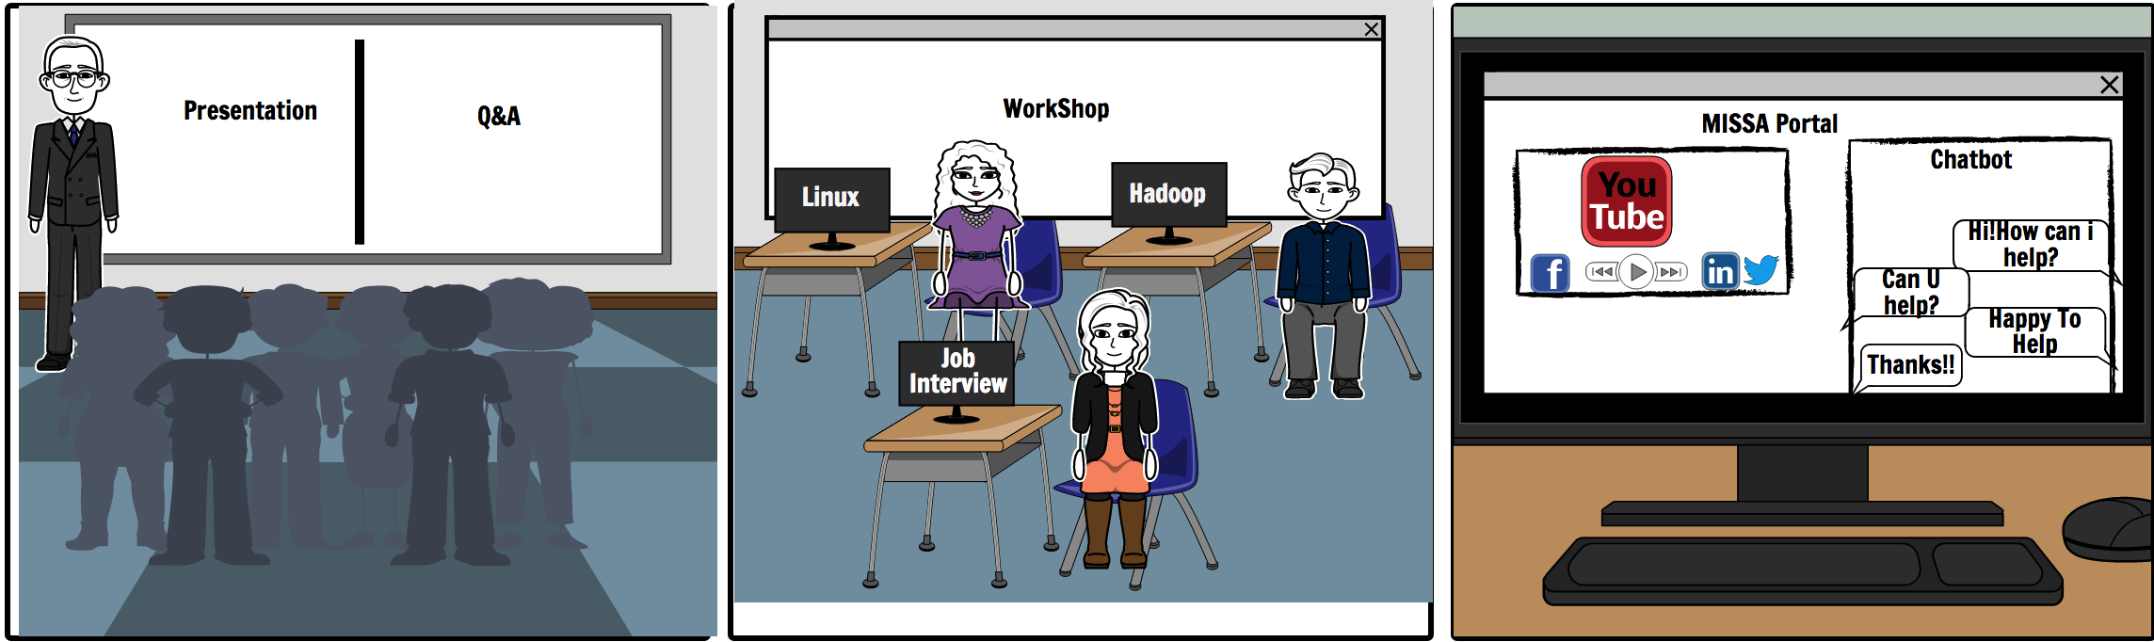
Prototype: Storyboard

Slide 15
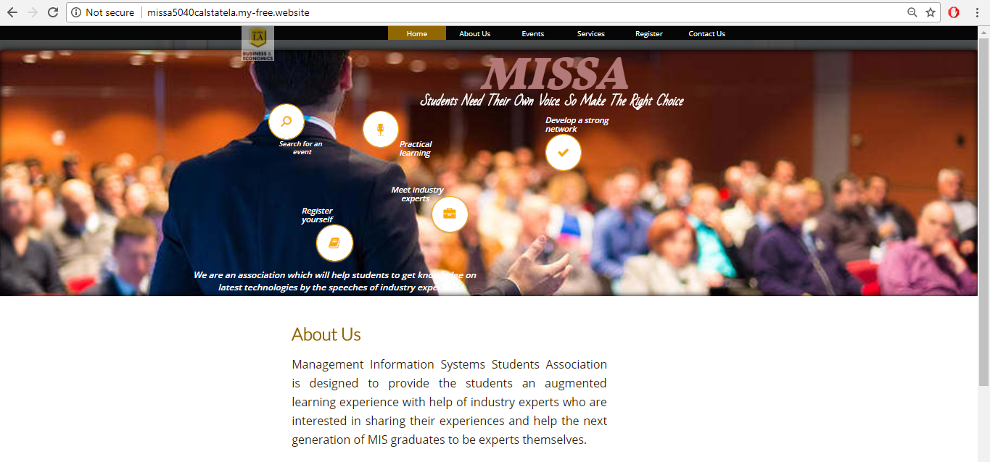
Our website link is available at
http://missa5040calstatela.my-free.website/
Our Software is a web portal with chat bot which has the following visualization :
Home Page

Slide 16
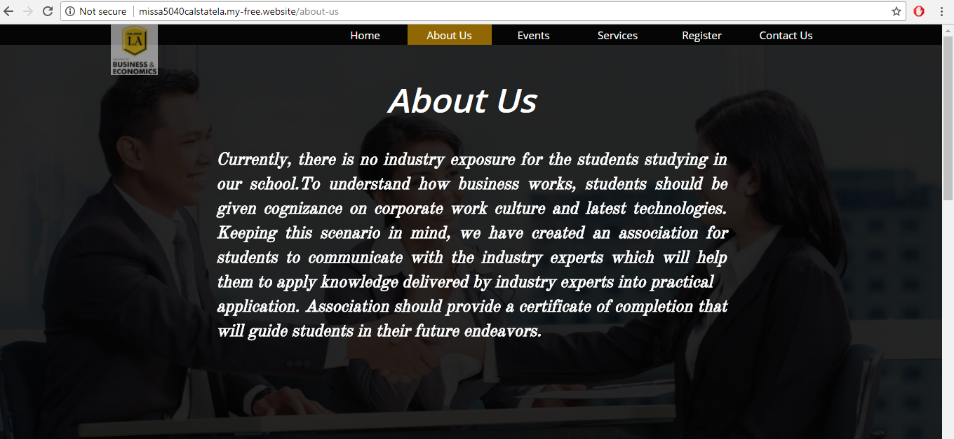
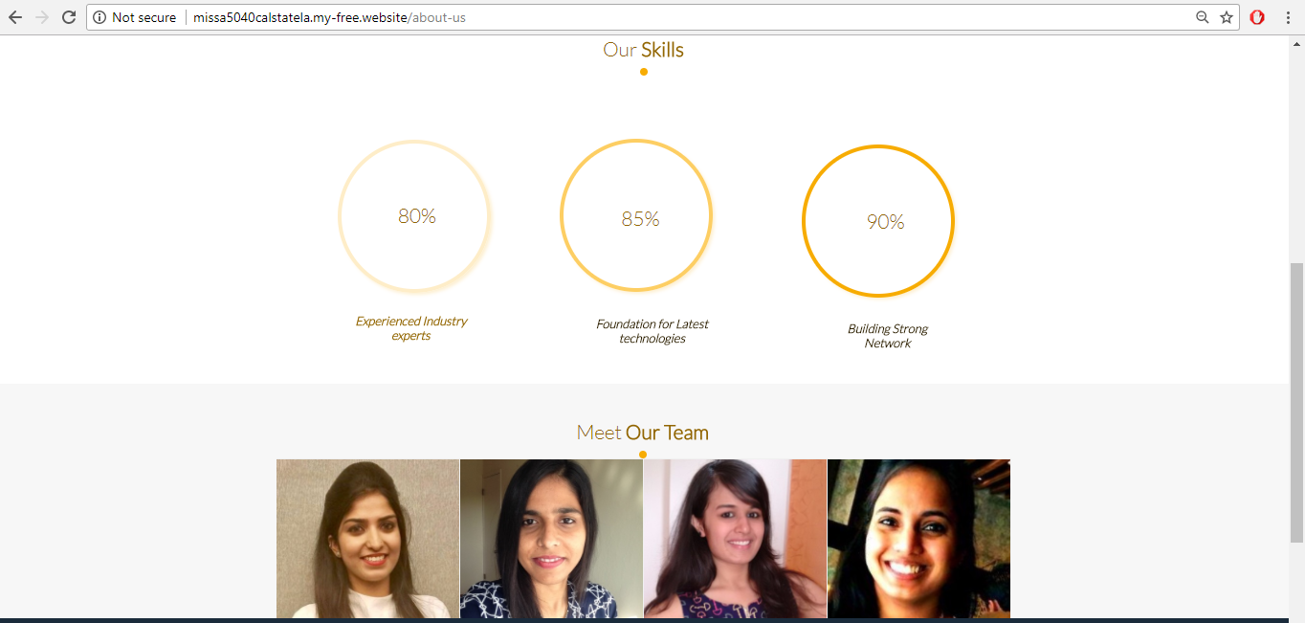
2) About Us

Slide 17
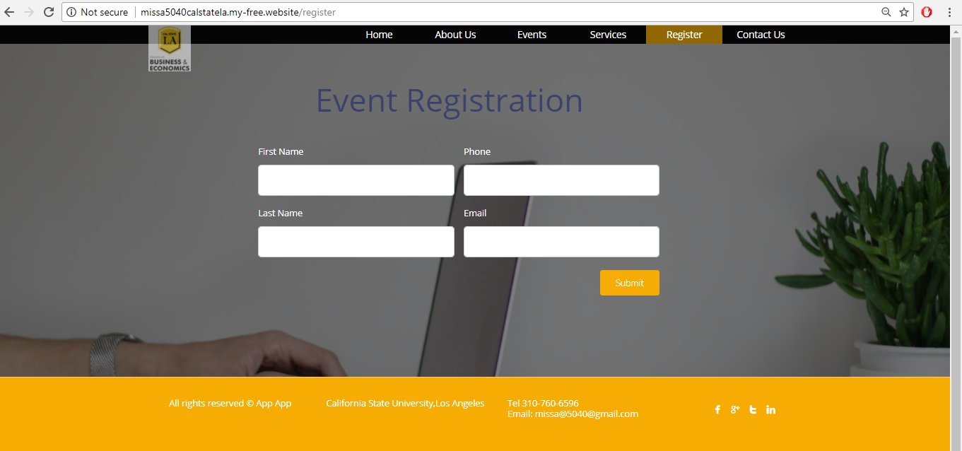
3) Events

Slide 18
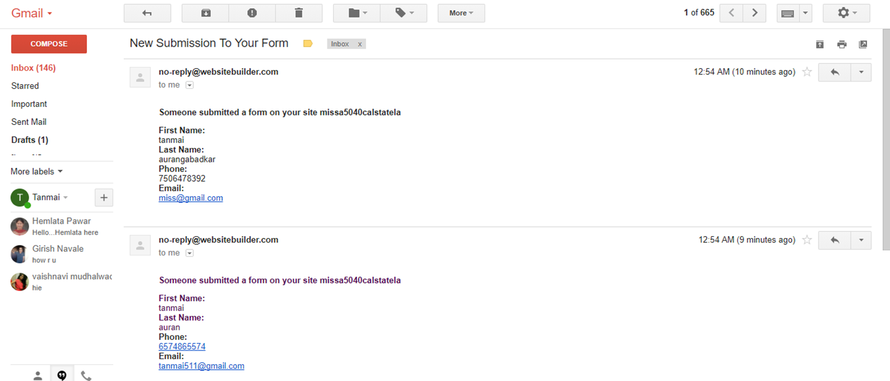
Email Notification to the student

Slide 19
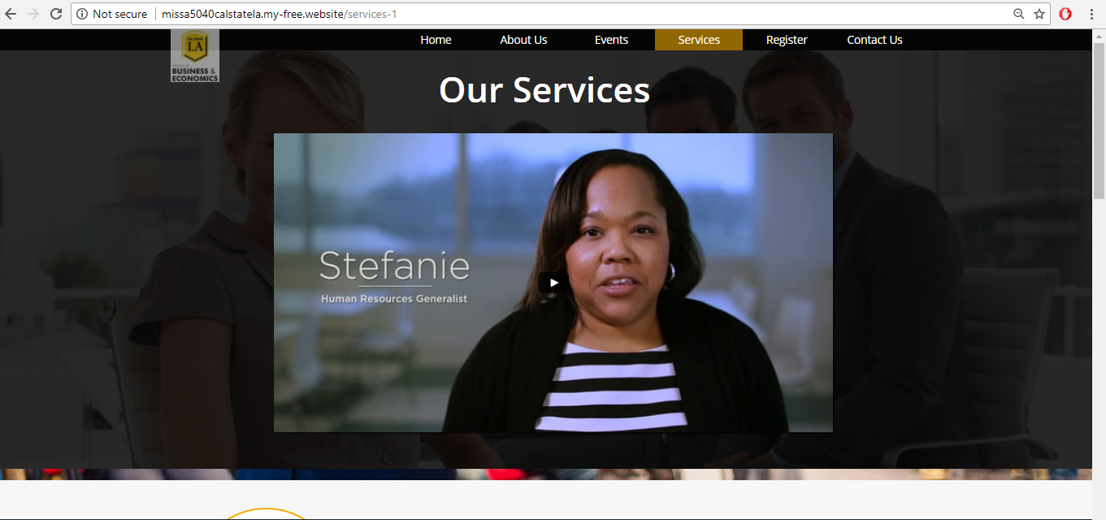
4) Services

Slide 20
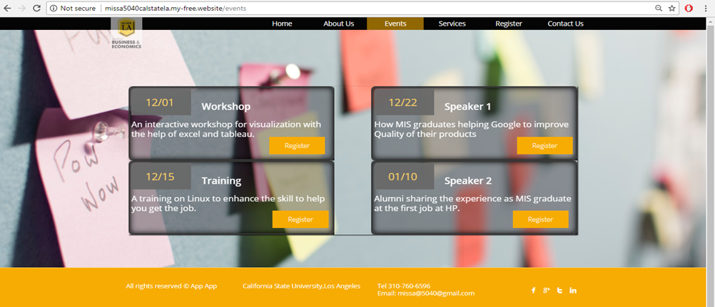
5) Services

Slide 21
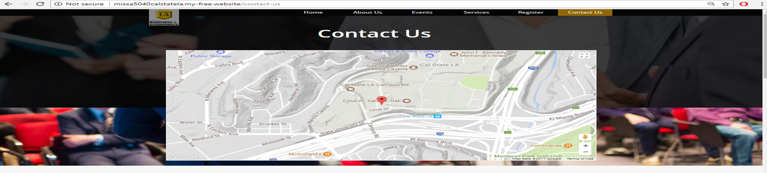
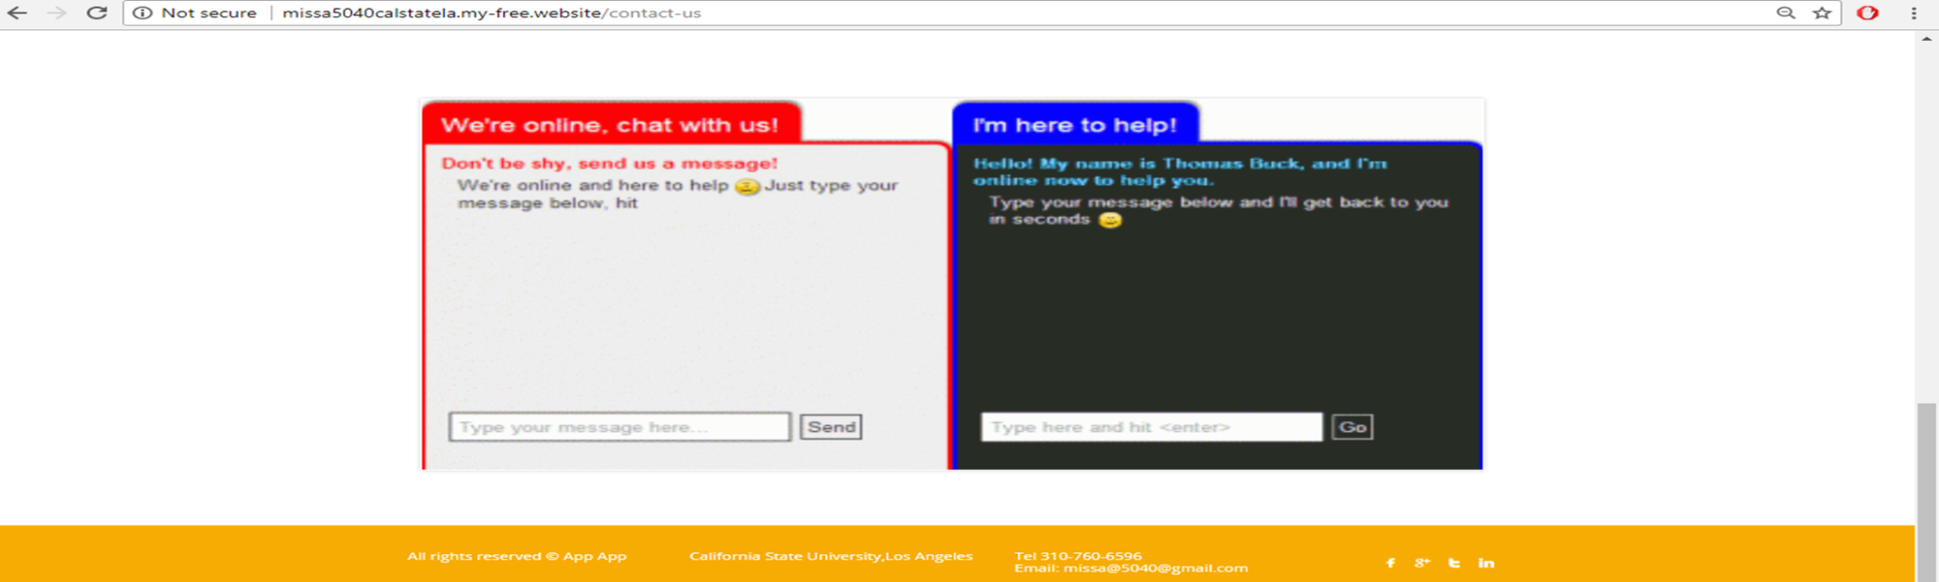
6) Contact Us

Slide 22
Thank You

